Slide 1


Your Logo
Date//Time//Year
Pitch
Deck
This is where you Input your summary of what your purpose here or
the problem and issue of what you want to solve.

Slide 2


Your Logo
About Our
Company
A Brief Story About The Company
In the presentation session, the background / introduction
can be filled with information that is arranged systematically
and effectively with respect to an interesting topic to be used
as material for discussion at the opening of the presentation
session. The introduction can provide a general overview for
those who are listening to your presentation so that the key
words on the topic of discussion are emphasized during this
background / introductory presentation session.

Slide 3
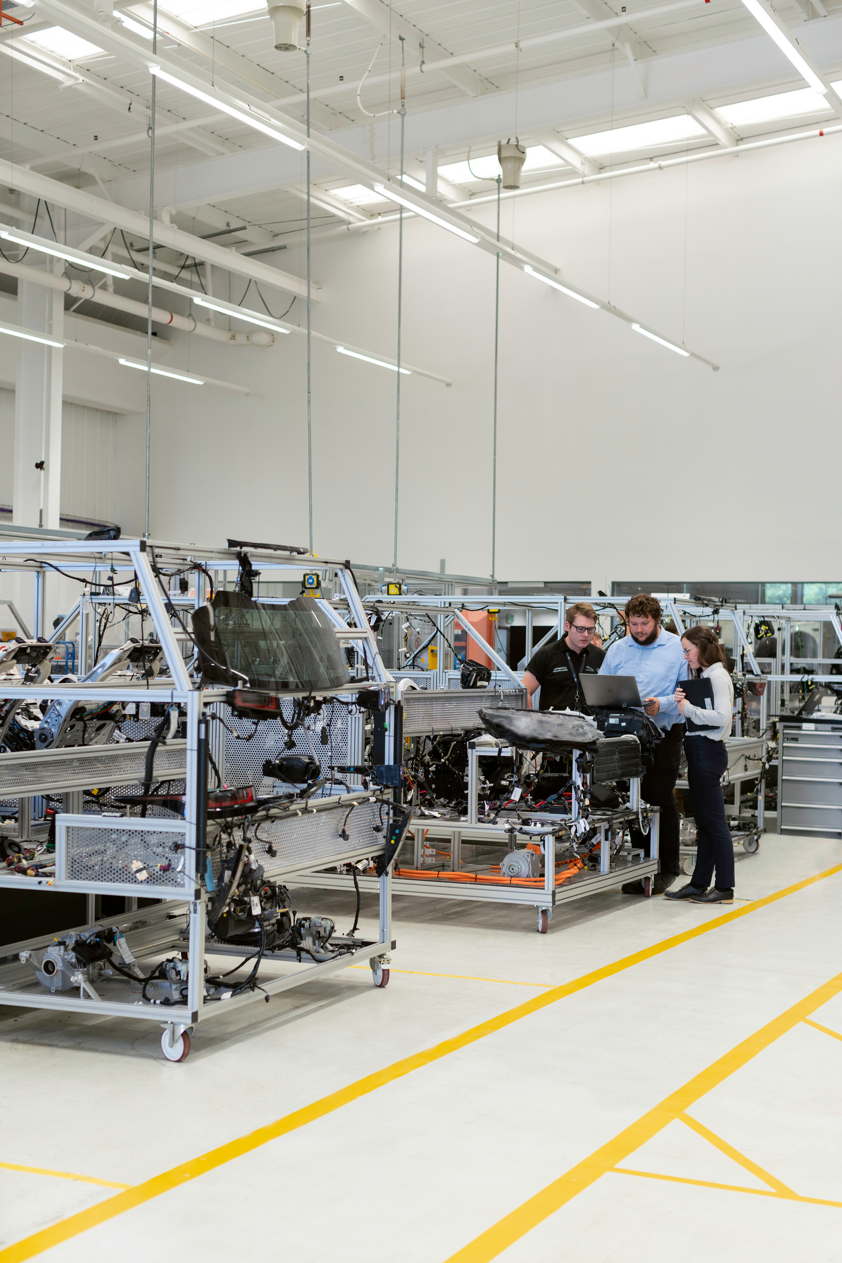
Your Logo
The Vision
A vision needs to be explain further and in detail because it is one
of main point about your future projection and your best goal.
The company perspective can be seen on this session.
The Mission
01
Explain your mission to
define how the vision can be
done. Most of people explain
the mission with assign a lot
of main issue of problems
02
Explain your mission to
define how the vision can be
done. Most of people explain
the mission with assign a lot
of main issue of problems
03
Explain your mission to
define how the vision can be
done. Most of people explain
the mission with assign a lot
of main issue of problems

Slide 4


Your Logo
Key Factors
01
Desire
02
Responsibility
Explain your the most powerful factor to
define how the company daily operations
can be done. Most of people often explain
the key factor depends on the primaries
and secondaries products/services data
Explain your the most powerful factor to
define how the company daily operations
can be done. Most of people often explain
the key factor depends on the primaries
and secondaries products/services data
03
Relations
04
Creative
Explain your the most powerful factor to
define how the company daily operations
can be done. Most of people often explain
the key factor depends on the primaries
and secondaries products/services data
Explain your the most powerful factor to
define how the company daily operations
can be done. Most of people often explain
the key factor depends on the primaries
and secondaries products/services data

Slide 5


Your Logo
Problems
The Society
The Environment
Identify large problem
areas with the eagle view
approach so that this macro
stage is useful for knowing
the outcome of our work.
Don't forget to highlight
how we see a problem,
because our personal
method will be a plus point.
A Brief Story About The Problems
A main problem needs to be discussed
further and in detail because this session
is one of the main foundation to be initial
development of a your product or service
and decision making in the future. Without
a well-defined problem, it will have an
big impact on a job that is unmanaged
The Climate
The Pandemics
Identify as many of these
problems as possible but
still have a relationship to
each of these problems so
that the work will be more
focused on one topic.
Identify as many of these
problems as possible but
still have a relationship to
each of these problems so
that the work will be more
focused on one topic.

Slide 6


Your Logo
Solutions
Market Driven Basic Implementation
Uphold the spirit of innovation and creativity in shaping a solution
that can be accepted by the wider community.
SEM Implementation
A Brief Story About The Solutions
Give an explanation that the solutions offered are based on data
and analysis that are very precise and focus on the problem.
Show that we offer a solution that solves the problems
previously described and identified. Make sure that the
solutions we offer uphold the values ​​of effectiveness,
efficiency, relation and relevant to the market situation
Decrease Industry GAP
The solutions offered need to be based on sound market decisions
so that they can have an impact.

Slide 7




Your Logo
Product
Overview
Internet of Things Tools
Describe one by one the products
we have in detail and effectively.
The more products / services
we have, it can show the level of
our exploration towards solving
community and market problems.
A Brief Story About The Product
Provide an explanation of the general
profile of the services we have. Arrange
information about our products services
in a systematic and fact-based manner.
Also express our pride in the service that
we have done well.
Artificial Intelligence
Describe one by one the products
we have in detail and effectively.
The more products / services
we have, it can show the level of
our exploration towards solving
community and market problems.

Slide 8

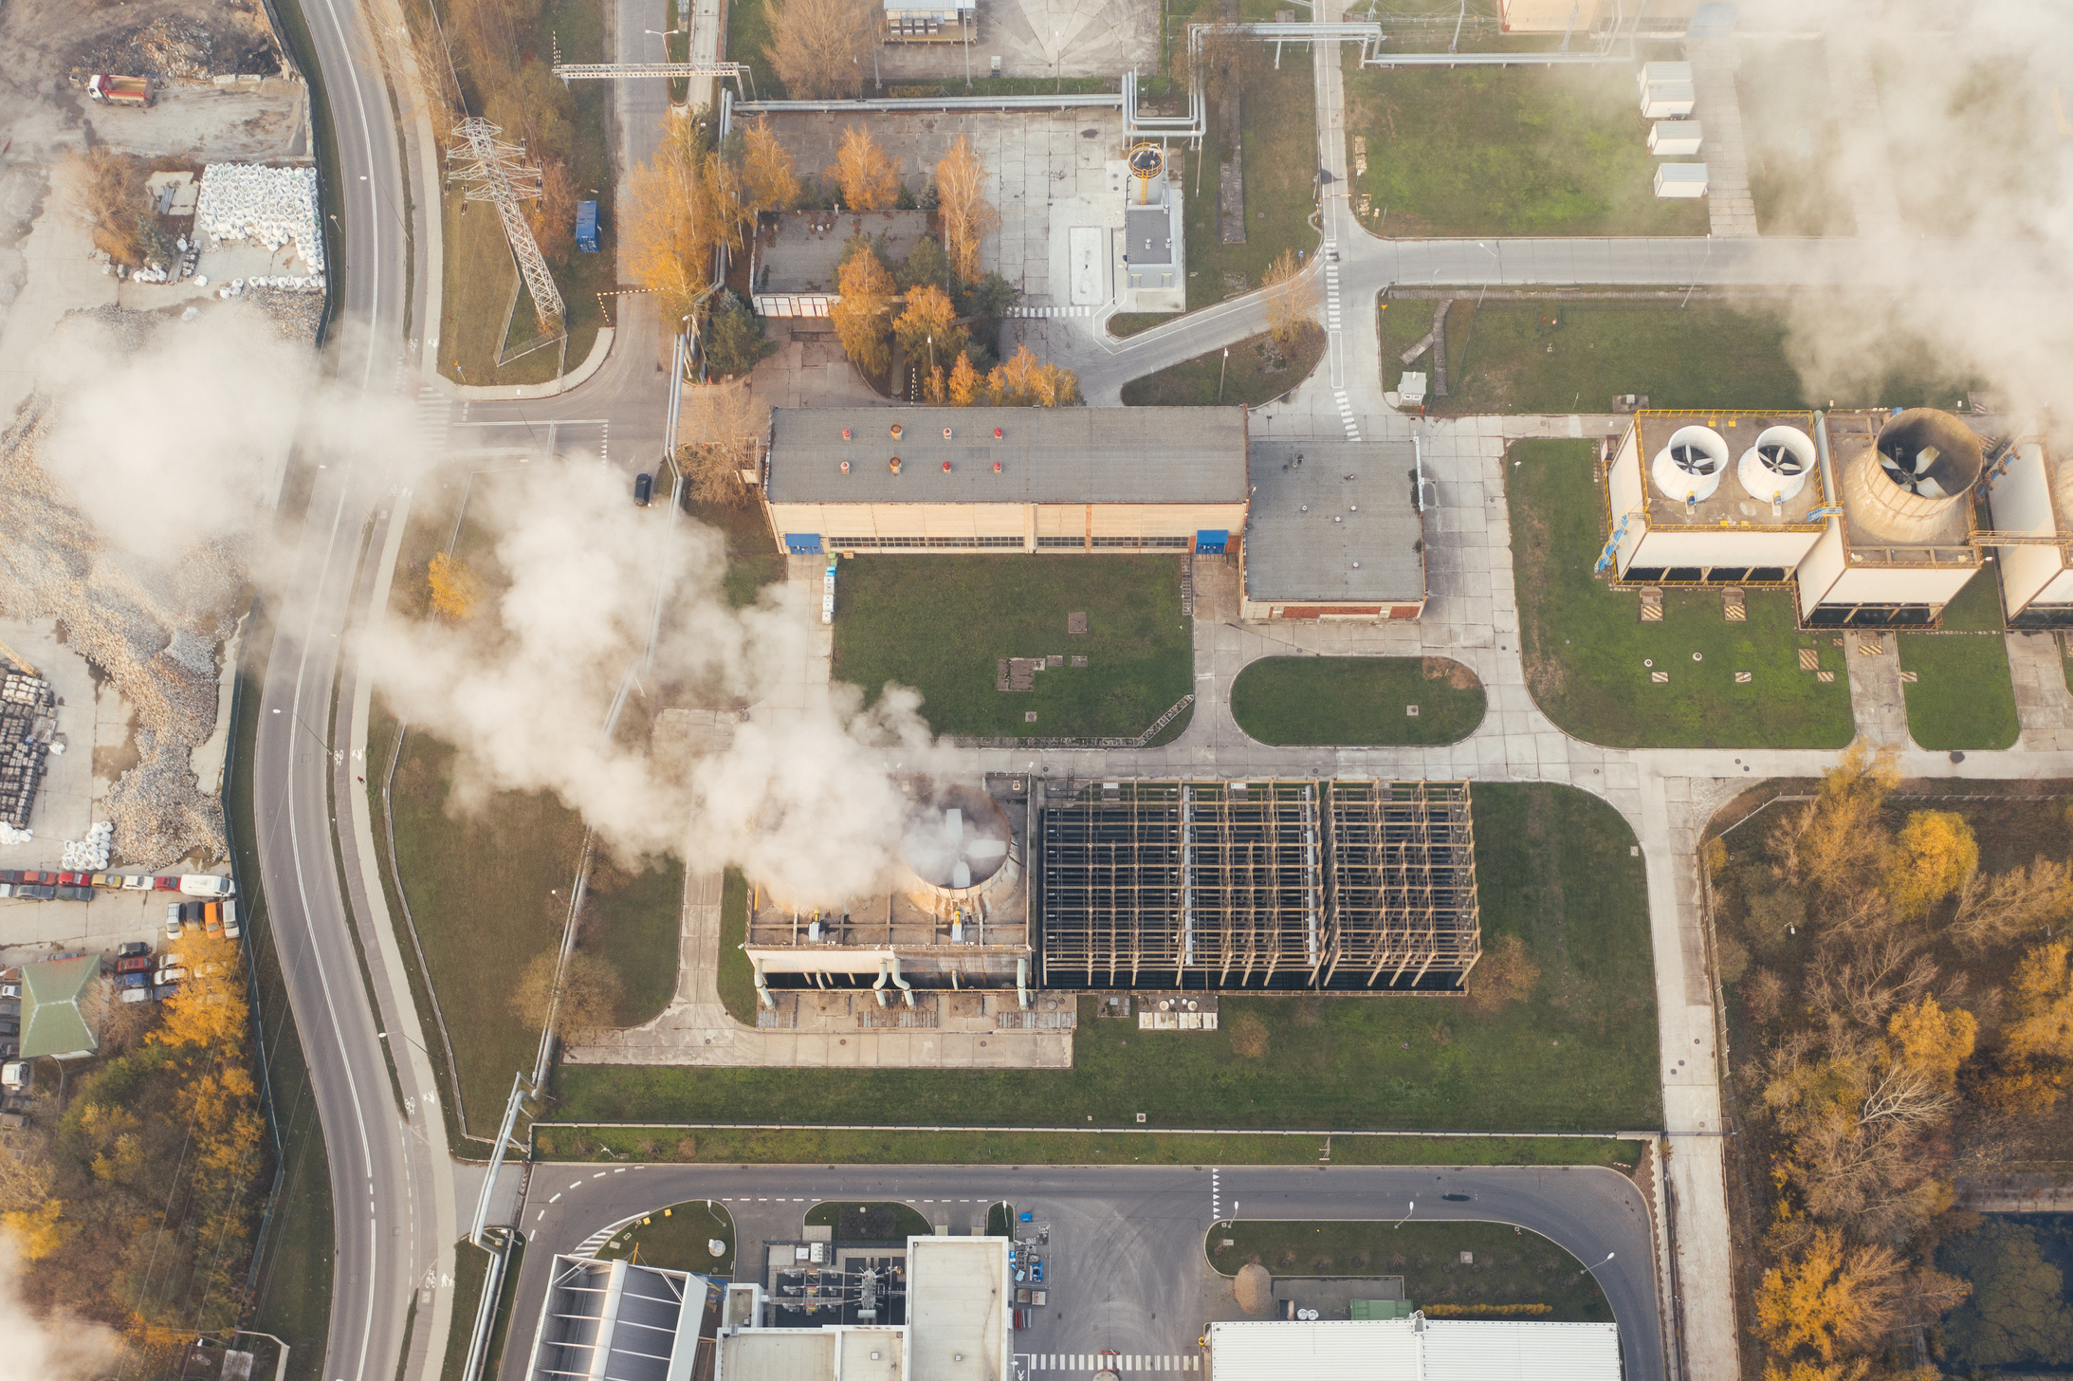
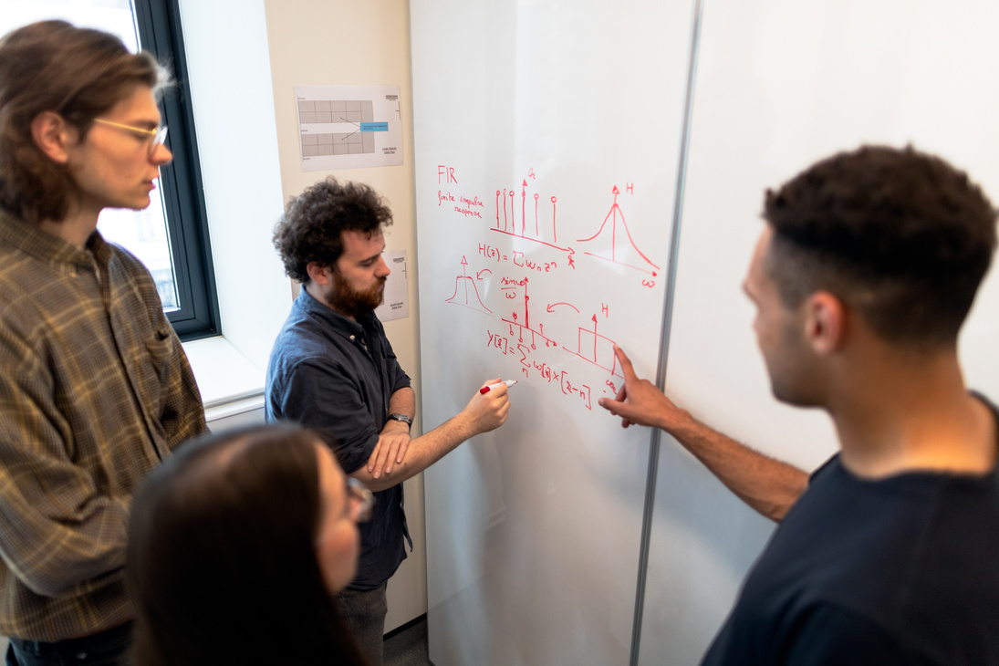


Your Logo
Product
Portfolio
A Brief Story About The Portfolio
Provide an explanation of the general
profile of the products we have. Arrange
information about our products/services
in a systematic and fact-based manner.
Also express our success stories and also
the pride in the products/service that done.

Slide 9

Your Logo
Product
Development
Timeline
2022
Research and Planning
Describe the products development
timeline phase by phase in detail
and effective.
2023
Promotion and Activation
Describe the products development
timeline phase by phase in detail
and effective.
2024
Planning New Variety of Product
Describe the products development
timeline phase by phase in detail
and effective.
2025
Monitoring and Evaluation
Describe the products development
timeline phase by phase in detail
and effective.

Slide 10

Your Logo
Market Size
Market size is the total amount of all sales and customers that can be seen directly
by stakeholders. This technique is usually calculated at the end of the year, the
market size can be used by companies to determine the potential of their market
and business in the future. This is very useful, especially for new companies that will
offer services to those who are interested in our services.
Total Available Market (TAM)
Serviceable Available Market (SAM)
Serviceable Obtainable Market (SOM)
$ 1.4 Billion
$ 194 Million
$ 167 Million
In the TAM Section, we can fill in the
potential of any person who can buy an
offer or the maximum amount of revenue
a business can earn by selling their offer.
It is a part of TAM that has the potential to
become a target market for the company by
considering the type of product, technology
available and geographical conditions.
The SOM is a smaller fraction of the SAM that
is the target of a serviceable and realistically
achievable market in the short to medium term.

Slide 11

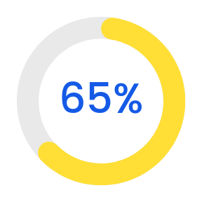
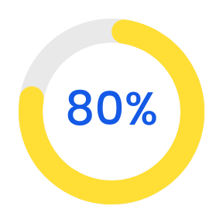
Your Logo
Market Targeting
Oil & Mining Company
Market targeting is the total amount of all
market availability that is usually calculated
when we start the company. Market size can
be used by companies to tell about potential
of their market and business in the future.
Construction Company
Market targeting is the total amount of all
market availability that is usually calculated
when we start the company. Market size can
be used by companies to tell about potential
of their market and business in the future.

Slide 12

Your Logo
Market
Validation
A Brief Story About Market Validation
It’s a market testing stage to ensure that
the products produced by the company
can be accepted and effectively used by
the broad market. For start-up companies,
we can use data already achieved by
similar products from other companies.
Really Great Site
Really Great Site
Really Great Site
2.650K
1.850K
1.010K
Total Users
Total Users
Total Users

Slide 13
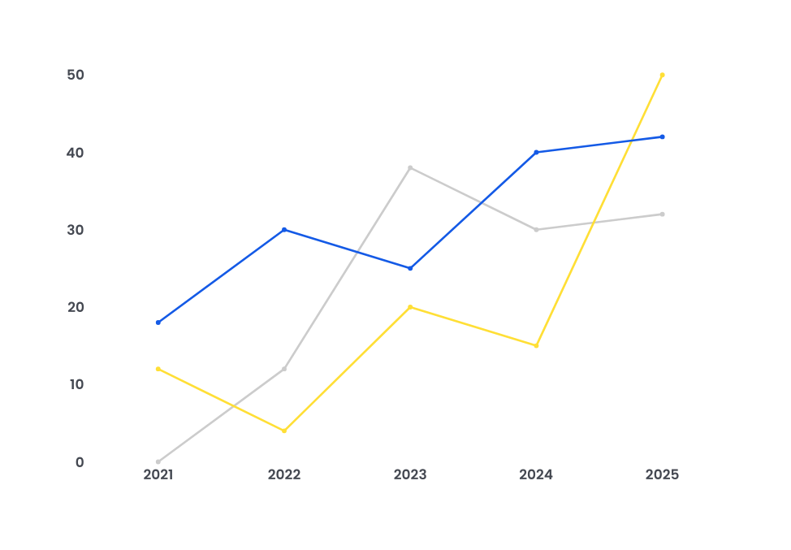
Your Logo
Company Traction
Traction is a period where the company is feeling
momentum during its development period. If traction
momentum is not harnessed, sales figures can decline
and the customer base can shrink. In general, companies
will judge success by the amount of revenue and new
customers they receive.
Artificial Intelligence
We can explain in detail the
momentum of the company
and the basic facts that are
taken to show that our
company is in a traction phase.
+75%
Internet of Things
We can explain in detail the
momentum of the company
and the basic facts that are
taken to show that our
company is in a traction phase.
+63%
We can explain in detail the
momentum of the company
and the basic facts that are
taken to show that our
company is in a traction phase.
Others Product
+32%

Slide 14
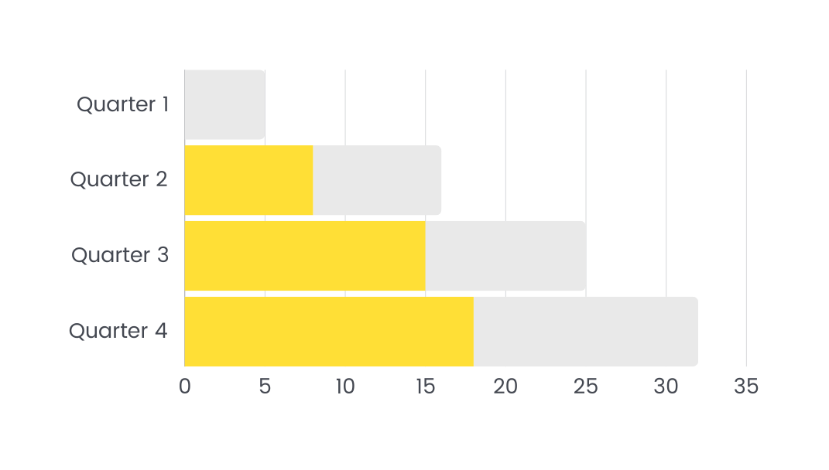



Your Logo
Product Performance
Revenue Development
3,46 M/Quarter
Engagement Development
87% - 91%/Quarter
Exposure Development
92% - 96%/Quarter

Slide 15

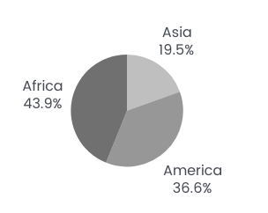

Your Logo
Performance Overview
The Internet of Things Product Overview
Provide an statistics explanation of the general profile of the products we have.
Arrange information about our products in a systematic and fact-based manner.
Also express our success stories and also the pride in the product that done lately.
Customer Satisfaction
Gross Profit Projection
94,43%
$ 192.1 M

Slide 16

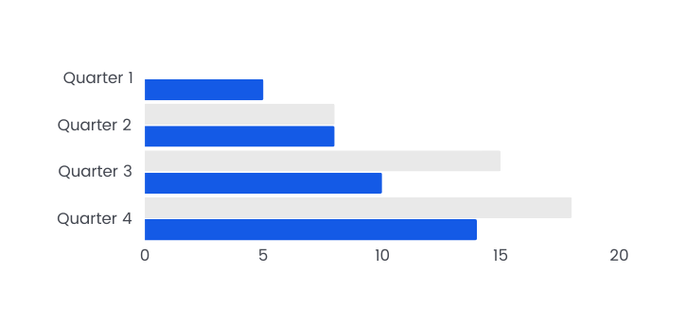
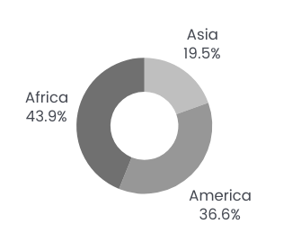
Your Logo
Performance Overview
Artificial Intelligence Product Overview
Customer Satisfaction
96,17%
Provide an statistics explanation of the general profile
of the products we have. Arrange information about our
products in a systematic and fact-based manner. Also
express our success stories and product that done lately.
Gross Profit Projection
$98,7 Million

Slide 17

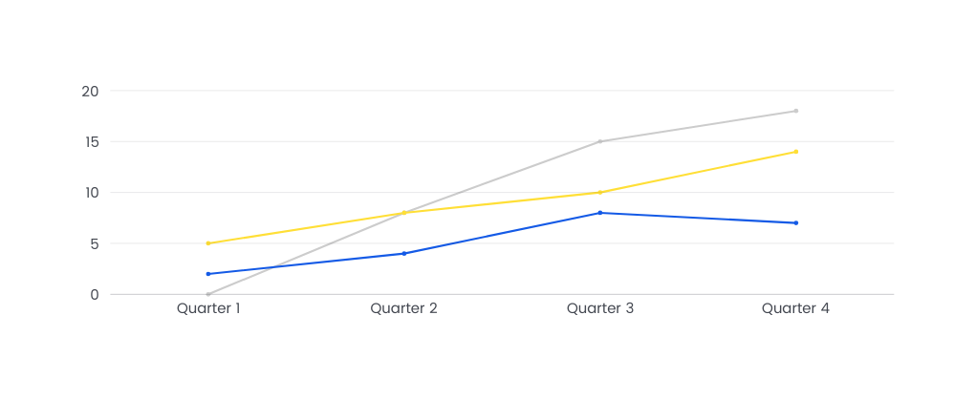
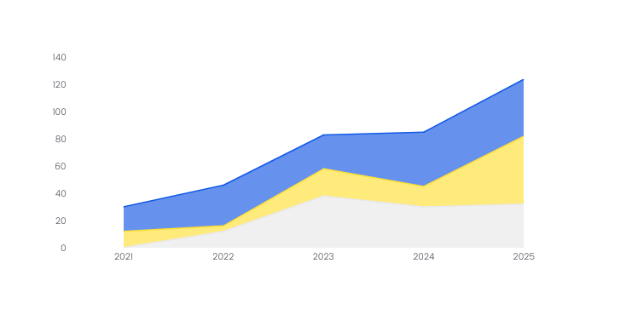
Your Logo
Performance Dashboard
4 : 6
Customer Loyalty Percentage Level
Branding Exposure
Effectivity Level
Project Value Average:
$ 146 Million
96%
92%
IOT Tools Vs AI Tools
Used Ratio
Sales Developing by Quarter:
Products Developing by Year:

Slide 18
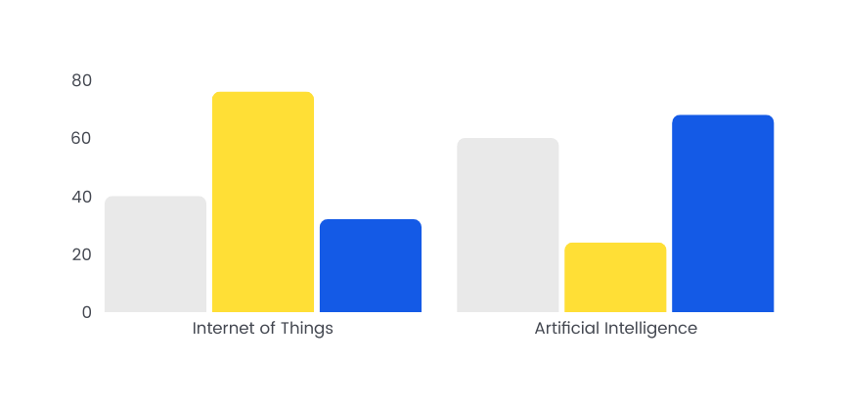
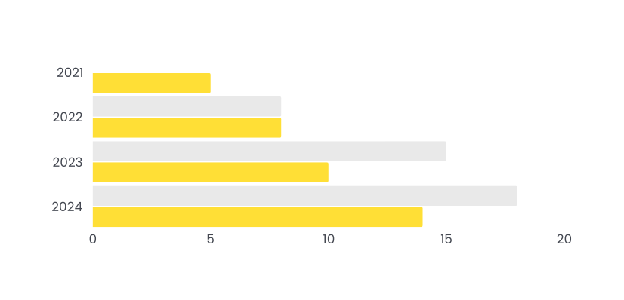

Your Logo
Business Model
Describe how to monetize, who your customers are,
distribution channels or fee structure. The goal is to get an
idea of how this business will survive your product or service
and tell how your company will make money and achieve its
goals.
Yearly Developing
The Ratio
67% - 82%
1:4 - 1:3

Slide 19

Your Logo
Competitive Advantage
Niche
We may offer products
or services that are
more unique or new
to the market than
our competitors.
Compact
We may offer products
or services that are
more unique or new
to the market than
our competitors.
Easy
Relationships are a gift
because they greatly
influence the exposure
of our products and
services.
Function
Relationships are a gift
because they greatly
influence the exposure
of our products and
services.
Agile
Offers a market
advantage that is more
focused according to
market needs than a
more general market.
Trend
Offers a market
advantage that is more
focused according to
market needs than a
more general market.

Slide 20







Your Logo
Direct & Indirect
Competitor
Direct
Indirect

Slide 21
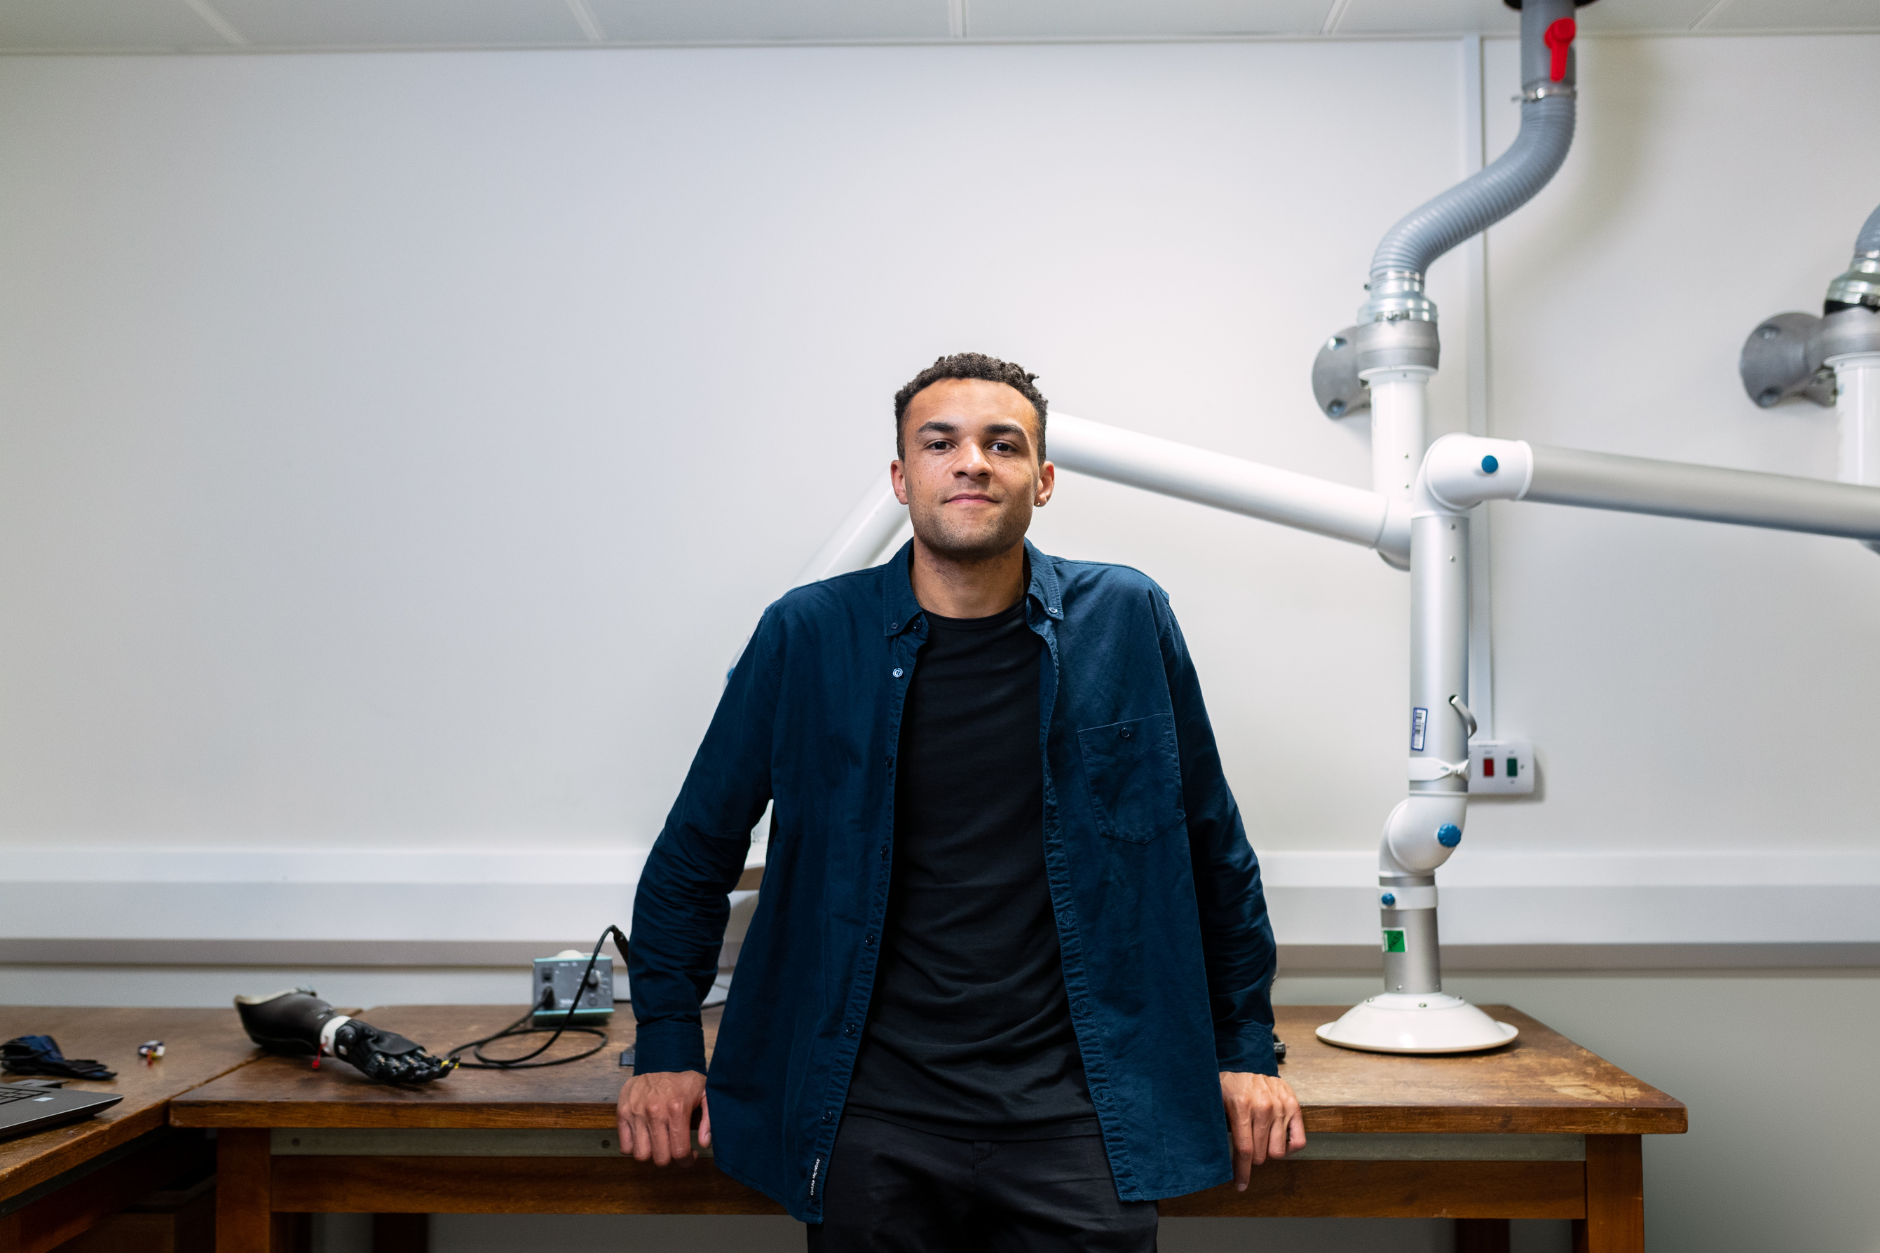
Your Logo
Our Super Team
Fill in the experience, assignments, and how
good your company team are. Include the
hobbies of the personnel to break the ice.
Team Effective
Level Percentage
Healthy Office
Ecosystem Percentage
Chemistry
Level
92%
96%
91%
Victor Olyssen
CEO & FOUNDER

Slide 22




Your Logo
Our Super Team
Ellen Jowdie
Collin Etihado
Sergio Pulenn
Whitney Sylla
CTO
COO
CCO
CFO

Slide 23



Thank You
Because, we're here to help
Address
123 Anywhere St., Any City, ST 12345
Write down your hopes for the future of
your company. Don't forget to thank the
company for the opportunity and convince
related parties to support your company.
Telephone
Website
+123-456-7890
www.reallygreatsite.com

